Slide 1
FPGA Trace Cores Design
by He Dai

Slide 2
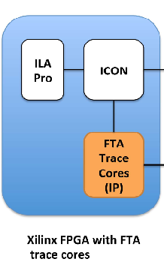
Objective:
Follow signal in Xilinx Chipscope IPs(ILA & ICON), get the signal out
If cannot get the signal from ICON, build a own IP to deliver the signal in selection
In Spartan 6 board

Slide 3
Work till now
Verilog, C++ language study
Xilinx ISE, Vivado tutorial
Zynq tutorial
AXI interface connected circuit
Read the ICON/ ILA core datasheet, build the circuit with it

Slide 4
Expected in later
After getting the Chipscope license, understand the whole process of getting the inner signal from FPGA pins
Build FTA trace cores IP in Spartan
JTAG connected with FPGA Trace Analyzer

